Slide 1
Learning Management System Database Forge Project 2
Date Updated: 05/31/2024
Presented By: Sea Snakes

Slide 2




Our Team
Melissa
Isaac
Anya
Aryan

Slide 3
Table of contents
01
02
03
04
05
06
Project Background
Client Objectives & Data Overview
SQL Database Population
MongoDB Database Population
Conclusion
SQL Database Usage
MongoDB Database Usage
Best Database Architecture & Questions
SQL Query Operations
MongoDB Query Operations

Slide 4
01
Project Background

Slide 5
Client Background
Company
Information
E-Learning Platform that offers a variety of courses (e.g: Coursera)
Create a Learning Management System database:
What is the Primary Objective?
Store and track the information of the courses, students, and grades, etc.
Calculate grades based on a student’s performance on their assignments/exams
What are the Secondary Objectives?
Determine a database architecture for the LMS database that best suits the client’s needs
SQL
Notes:
mel

Slide 6
Required Tables
Assignments
Variable Name |  | Description
Assignment_Id | Categorical, Char. | Assignment Idenifier (e.g: 12345M)
CourseCode | Categorical, Int.. | Course Section (e.g: 12345)
Assignment Title | Categorical, Char. | Assignment Title (e.g: Midterm)
Weight | Quantitative, Numeric. | Weighted Numerics (e.g; 0.1)
Grades
Variable Name |  | Description
Student_Id | Categorical, Char. | Unique Student Identifier (e.g: ab3zj)
Assignment_Id | Categorical, Char. | Assignment Idenifier (e.g: 12345M)
Score | Quantitative, Numeric | 0-100 Score of Assignment Grade
Courses
Variable Name |  | Description
CourseCode (PK) | Categorical, Int. | Course Section (e.g: 12345)
Course_Name | Categorical, Char. | Course Title (e.g STAT 2120)
Description | Categorical, Char. | Written Course Title (e.g: Introduction to Statistics)
Instructor | Categorical, Char. | Instructor Full Name
Students
Variable Name |  | Description
Student_Id | Categorical, Char. | Unique Student Identifier (e.g: ab3zj)
First_Name | Categorical, Char. | Student First Name
Last_Name | Categorical, Char. | Student Last Name
Email | Categorical, Char. | Email (e.g: ab3zj@email.com)
Courses
Assignments
Stores Information for each course (course, code, description, etc.)
Stores information of each assignment (title, course, title, etc.)
Students
Grades
Stores information for each student (name, ID, email, etc.)
Stores information of each grade transaction (student, course, assignment, score, etc.)
Notes:
mel

Slide 7
02
SQL Database
Population
Notes:
anya

Slide 8
Relational Diagram:
A Missing Link
StudentCourses
?
Connection Between
Course and Student
Student_Id (FK)
Code (FK)
Course
Student
Code
Course_Name
Description
Instructor
Student_Id
First_Name
Last_Name
Email
Assignment
Grades
Assignment_Id
Code (FK)
Assignment_Title
Weight
Student_Id (FK)
Assignment_Id (FK)
Scores
Notes:
Anya; Objective: Tracking & Storing Information

Slide 9
Populating the Database
Create Database
Read in each CSV File
Populate with to_sql
Use Database
Created an empty database in SQL Workbench
Used Python in a Jupyter notebook to read each raw CSV via Github Link
Populate the SQL database with the to_sql function
(via Python in Jupyter Notebook)
Let the Querying Begin!
Notes:
Anya; After creating the StudentCourses table, we created an empty database in SQL Workbench, and then used Python in a Jupyter notebook to read each csv from our github page and populate the SQL database with the to_sql function. Once we did that, it was ready for querying.

Slide 10
03
MongoDB
Database
Population

Slide 11
Populating the MongoDB Database
Merge each CSV File
Nest the data
Populate MongoDB
Use Database
(After reading in each raw CSV file via Github Link)
Used Python in a Jupyter notebook to merge each CSV strategically for nesting
Nest the merged data in dictionary (JSON) format fit for MongoDB
(Via Python in a Jupyter notebook)
Populate the MongoDB database with the nested data
via insert_many() function
(Via Python in a Jupyter notebook)
Let the querying
begin!
Notes:
Aryan; After creating the StudentCourses table, we created an empty database in SQL Workbench, and then used Python in a Jupyter notebook to read each csv from our github page and populate the SQL database with the to_sql function. Once we did that, it was ready for querying.

Slide 12
Each course gets represented in mongo doc like this:
Code:11386,
Course_Name:”SLAV_2360”,
Students:
Student1
Student_ID:”rqb6bc”
First_Name:”Melissa”
Last_Name:”Zheng”
Email: ”rqb6bc@virginia.edu”
Student2
Student_ID:”zds3st”
First_Name:”Isaac”
Last_Name:”Tabor”
Email: ”zds3st@virginia.edu”
Assignment:
Assignment1
Assignment_Id:11386E1,
Assignment_Title:”Exam 1”,
Weight:.1
Grades:
Student1
Student_ID: ”zds3st”
Score: 80
Code:12564,
Course_Name:”STAT_1601”,
Students:
Student1
Student_ID:”pfg9yq”
First_Name:”Anya”
Last_Name:”Hariharan”
Email: ”pfg9yq@virginia.edu”
Student2
Student_ID:”mcf5yc”
First_Name:”Aryan”
Last_Name:”Prabhudesai”
Email: ”mcf5yc@virginia.edu”
Assignment:
Assignment1
Assignment_Id:12564E1,
Assignment_Title:”Exam 1”,
Weight:.1
Grades:
Student1
Student_ID: ”pfg9yq”
Score: 80
Notes:
Issac; Objective: Tracking & Storing Information

Slide 13
SQL Database
Usage
04
Notes:
Anya

Slide 14
Primary Objective:
To Calculate Someone’s Grades
Query:
Output:
Select columns you want to display
Have to manually calculate course grades
Join all the tables together on relevant primary and foreign keys
Inner_Join
Filter for a specific Student ID
Group By Student ID, Code, First Name, Last Name, Course Name
Student_ID | Code | First_Name | Last_Name | Course_Name | Course_Grade
zds3st | 12736 | Isaac | Tabor | COMM_2020 | 67.14
zds3st | 12564 | Isaac | Tabor | STAT_1601 | 72.10
zds3st | 11386 | Isaac | Tabor | SLAV_2360 | 80.04
zds3st | 14730 | Isaac | Tabor | COMM_3410 | 73.44
Notes:
Anya

Slide 15
MongoDB
Database
Usage
05

Slide 16
Primary Objective: To Calculate Someone’s Grades
Match the specific Student_ID
Unwind the Students array
Further filter for the specific Student_ID after unwinding
Lookup to join Assignments and unwind Grades
Unwind the joined array
Group by necessary fields to calculate the total score and total weight for each student in each course
Project the final results
Perform aggregation
Print the results
Output:
{'Student_ID': 'zds3st', 'Course_Code': 12736, 'First_Name': 'Isaac', 'Last_Name': 'Tabor', 'Course_Name': 'COMM_2020', 'CourseGrade': 67.14}
{'Student_ID': 'zds3st', 'Course_Code': 14730, 'First_Name': 'Isaac', 'Last_Name': 'Tabor', 'Course_Name': 'COMM_3410', 'CourseGrade': 73.44}
{'Student_ID': 'zds3st', 'Course_Code': 12564, 'First_Name': 'Isaac', 'Last_Name': 'Tabor', 'Course_Name': 'STAT_1601', 'CourseGrade': 70.675}
{'Student_ID': 'zds3st', 'Course_Code': 11386, 'First_Name': 'Isaac', 'Last_Name': 'Tabor', 'Course_Name': 'SLAV_2360', 'CourseGrade': 80.325}

Slide 17
06
Conclusion

Slide 18


Secondary Objective
Database Management Comparison
SQL vs. MongoDB
SQL performs more efficiently with smaller datasets or self-generated data | Handles larger datasets > ~10,000 entries more efficiently
SQL does not inherently support embedding or nested documents. | MongoDB supports embedding documents and arrays within other documents which is known as nesting
SQL requires “JOINS” because datasets are not previously merged | MongoDB requires merging for JSON format (dictionary) so no complex joins are required
Horizontal scaling is challenging due to fixed schemas, which create obstacles in data distribution and manipulation. | MongoDB has Schema and Horizontal flexibility allowing for enhanced data efficiency
Notes:
Aryan

Slide 19
Final Conclusion
The Better Database?
Characteristics of Client LMS Dataset
SQL V. MongoDB Comparison
Smaller Dataset (Generated Data)
SQL
Less use of Joins
Structured Data Model
(e.g: Relational data & Predefined Schema)
SQL
Complex Queries
(e.g: Calculating weighted grades based on performance on assignments)
SQL
Larger Datasets (Scalability)
(e.g: JSON format can account for Increased schema complexity such as adding more information to a collection)
MongoDB

Slide 20
Thanks!
Do you have any questions?
Team Contacts:
rqb6bc@virginia.edu (Melissa Zheng)
zds3st@virginia.edu (Isaac Tabor)
mcf5yc@virginia.edu (Aryan Prabhudesai)
anyahariharan@gmail.com (Anya Hariharan)
Please keep this slide for attribution

Slide 21
Appendix

Slide 22
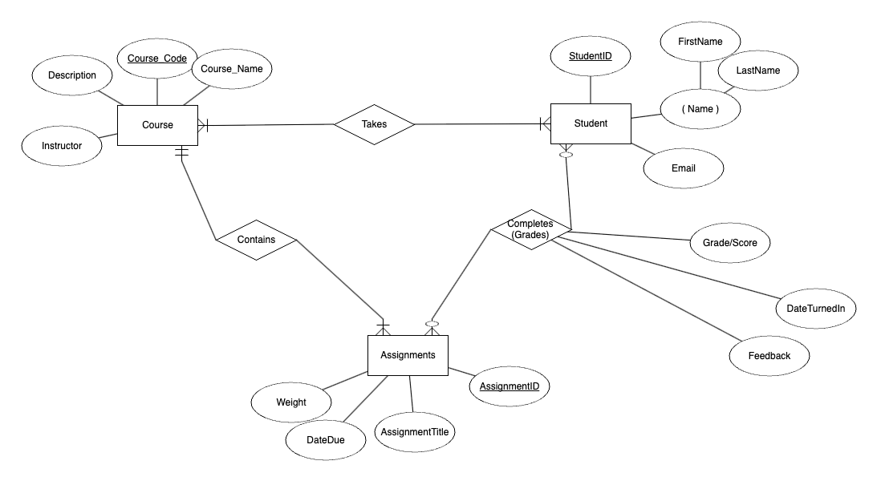
ERD

Slide 23
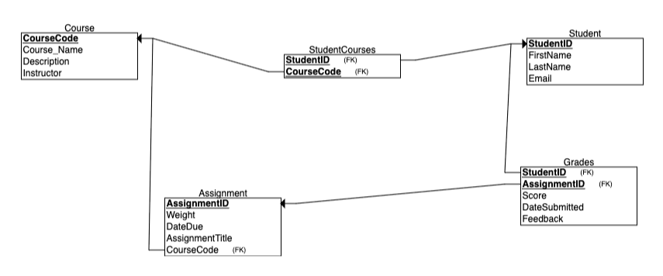
Relational Schema

Slide 24
Primary Objective 1:
To Calculate Someone’s Grades
Query:
Output:
SELECT s.Student_ID, a.Code, s.First_Name, s.Last_Name,
c.Course_Name,
SUM(g.Score * a.Weight) / SUM(a.Weight) AS CourseGrade
FROM Grades AS g
INNER JOIN Assignments a
ON g.Assignment_Id = a.Assignment_Id
INNER JOIN Courses AS c
ON a.Code = c.Code
INNER JOIN StudentClasses AS sc
ON c.Code = sc.Code
INNER JOIN Students AS s
ON sc.Student_ID = s.Student_ID
WHERE s.Student_ID = 'zds3st'
GROUP BY s.Student_ID, a.Code, s.First_Name, s.Last_Name, c.Course_Name;
Student_ID | Code | First_Name | Last_Name | Course_Name | CourseGrade
zds3st | 12736 | Isaac | Tabor | COMM_2020 | 67.14
zds3st | 12564 | Isaac | Tabor | STAT_1601 | 72.10
zds3st | 11386 | Isaac | Tabor | SLAV_2360 | 80.04
zds3st | 14730 | Isaac | Tabor | COMM_3410 | 73.44
Notes:
Anya

Slide 25
Primary Objective:
To Calculate Someone’s Grades
Query:
pipeline = [
# Match the specific Student_ID
{"$match": {"Students.Student_ID": "zds3st"}},
# Unwind the Students array
{"$unwind": "$Students"},
# Further filter for the specific Student_ID after unwinding
{"$match": {"Students.Student_ID": "zds3st"}},
# Lookup to join Assignments and unwind Grades
{"$lookup": {
"from": "courses",
"let": {"courseCode": "$Code"},
"pipeline": [
{"$match": {"$expr": {"$eq": ["$Code", "$$courseCode"]}}},
{"$unwind": "$Assignments"},
{"$unwind": "$Assignments.Grades"},
{
"$project": {
"_id": 0,
"Assignment_Weight": "$Assignments.Weight",
"Grade_Score": "$Assignments.Grades.Score"
} } ],
"as": "AssignmentsWithGrades" } },
# Unwind the joined array
{"$unwind": "$AssignmentsWithGrades"},
# Group by necessary fields to calculate the total score
and total weight for each student in each course
{
"$group": {
"_id": {
"Student_ID": "$Students.Student_ID",
"Course_Code": "$Code",
"Course_Name": "$Course_Name",
"First_Name": "$Students.First_Name",
"Last_Name": "$Students.Last_Name"
},
Notes:
Issac

Slide 26
Key Example: To Calculate Someone’s Grades - Cont’d
Query - Cont’d:
"then": None, # or you could use 0 or another default value
"else": {"$divide": ["$Total_Score", "$Total_Weight"]} } } } }]
# Perform aggregation
result = db.courses.aggregate(pipeline)
# Print the results
for doc in result:
print(doc)
"Total_Score": {
"$sum": {
"$multiply": [
"$AssignmentsWithGrades.Grade_Score",
"$AssignmentsWithGrades.Assignment_Weight"
]
} },
"Total_Weight": {"$sum": "$AssignmentsWithGrades.Assignment_Weight"}
}
},
# Project the final results
{
"$project": {
"_id": 0,
"Student_ID": "$_id.Student_ID",
"Course_Code": "$_id.Course_Code",
"First_Name": "$_id.First_Name",
"Last_Name": "$_id.Last_Name",
"Course_Name": "$_id.Course_Name",
"CourseGrade": {
"$cond": {
"if": {"$eq": ["$Total_Weight", 0]},
Output:
{'Student_ID': 'zds3st', 'Course_Code': 12736, 'First_Name': 'Isaac', 'Last_Name': 'Tabor', 'Course_Name': 'COMM_2020', 'CourseGrade': 67.14}
{'Student_ID': 'zds3st', 'Course_Code': 14730, 'First_Name': 'Isaac', 'Last_Name': 'Tabor', 'Course_Name': 'COMM_3410', 'CourseGrade': 73.44}
{'Student_ID': 'zds3st', 'Course_Code': 12564, 'First_Name': 'Isaac', 'Last_Name': 'Tabor', 'Course_Name': 'STAT_1601', 'CourseGrade': 70.675}
{'Student_ID': 'zds3st', 'Course_Code': 11386, 'First_Name': 'Isaac', 'Last_Name': 'Tabor', 'Course_Name': 'SLAV_2360', 'CourseGrade': 80.325}
Notes:
Issac; Obviously need to make this look prettier but idea there for now

Slide 27
Strategic Merge Code
# Merge student_courses with students to get student names
student_courses_merged = pd.merge(StudentClasses2, students, on='Student_ID')
# Merge the result with courses to get course names
full_merge = pd.merge(student_courses_merged, courses, left_on='Code', right_on='Code')
# Merge assignments with courses to get course names
assignments_merged = pd.merge(Assignments, courses, on='Code')
# Merge grades with assignments to get assignment names
grades_merged = pd.merge(Grades, assignments_merged, on='Assignment_Id')
# Merge grades with students to get student names
grades_merged = pd.merge(grades_merged, students, on='Student_ID')

Slide 28
Nesting Code
nested_data = []
for course_code, group in full_merge.groupby('Code'):
course_name = group['Course_Name'].values[0]
students = group[['Student_ID', 'First_Name','Last_Name','Email']].drop_duplicates().to_dict('records')
# Get assignments for the course
course_assignments = assignments_merged[assignments_merged['Code'] == course_code]
assignments_list = []
for _, assignment in course_assignments.iterrows():
assignment_id = assignment['Assignment_Id']
assignment_name = assignment['Assignment_Title']
assignment_weight = assignment['Weight']
# Get grades for the assignment
assignment_grades = grades_merged[grades_merged['Assignment_Id'] == assignment_id]
grades_list = assignment_grades[['Student_ID', 'Score']].to_dict('records')
assignments_list.append({
'Assignment_Id': assignment_id,
'Assignment_Title': assignment_name,
'Weight': assignment_weight,
'Grades': grades_list
})
nested_data.append({
'Code': course_code,
'Course_Name': course_name,
'Students': students,
'Assignments': assignments_list
})

